Slide 1
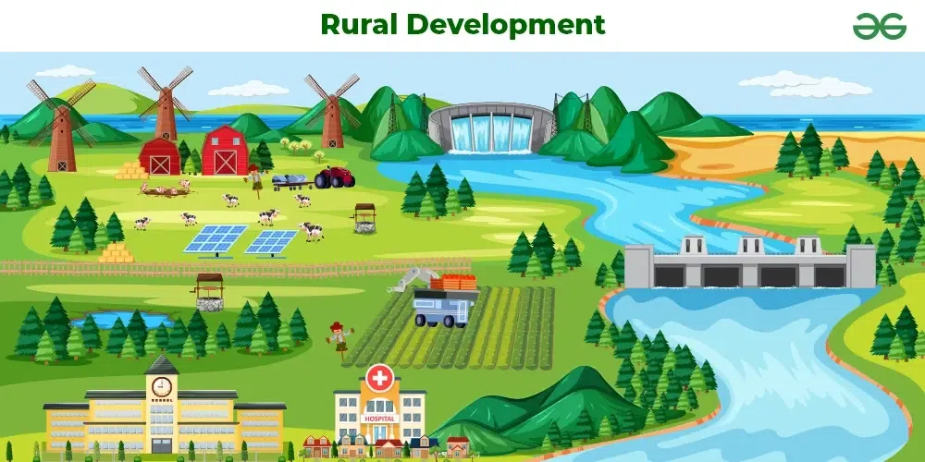
Gramvaani
ನಿಮ್ಮ ಮಾತು ,
ನಮ್ಮ ಬದಲಾವಣೆ.
Presented by:-
Tukaram – 21SEAD38

Slide 2
Introduction:
Education
The Gramvaani Platform can significantly impact the sectors of education, health, and agriculture by improving access, accountability, and responsiveness in local governance.
The Gramvaani Platform serves as a vital tool for social development by empowering citizens, enhancing governance, and promoting social justice. It fosters an engaged and informed community, ultimately contributing to a more equitable and sustainable society
Health
Social development
Agricultural
Holistic Development of Children
Voice for Justice
2
The Gramvaani Platform has the potential to significantly enhance village development by improving governance, increasing citizen engagement, and fostering economic growth. By addressing grievances effectively.
By Gramvaani effective communication between citizens and local authorities, the platform enhances accountability, improves public services, and promotes community engagement.
Transportation
Village
Development
Law and Order
welfare schemes
Accountability in Action
Redress for Rights

Slide 3
Current Situation :
Inefficient Reporting: Villagers often struggle to report issues related to electricity, water supply, and healthcare services. The platform streamlines this process, making it easier to communicate problems directly to authorities.
Slow Processing Times: Grievances often remain unresolved for extended periods. The platform sets clear timelines for addressing complaints, helping to ensure timely responses from authorities.
Delayed Resolution of Issues
Bridging Gaps in Community Services
Manual Processes: Traditional methods of reporting grievances, such as written letters or in-person visits, are slow and bureaucratic. The platform digitizes this process, speeding up communication and resolution.
Access to Services
Lack of Transparency
Disconnection from Community Needs: Local authorities may lack insight into community issues. The platform aggregates grievances, providing valuable data that helps authorities understand and prioritize community needs.
Inequities in Service Delivery
Current
Knowledge Gaps: Many villagers are unaware of their rights and the mechanisms available for reporting issues. The platform can provide educational resources, raising awareness and empowering citizens.
Problems
Inefficient Communication
Limited Awareness of Rights
Inequities
Marginalized Groups: Vulnerable populations often face additional barriers to accessing services. The platform can ensure that their grievances are heard and addressed, promoting social equity.
Access to Benefits: Issues related to the implementation of welfare schemes, such as delays in receiving benefits or lack of awareness about available services, can be reported and addressed through the platform.

Slide 4

Over Solution :
Real-Time Tracking and Updates
Streamlined Communication
Clear Timelines for Resolution
Solution:
Implement a system that allows villagers to track the status of their complaints in real time, providing updates at each stage of the resolution process.
This transparency reduces uncertainty and builds trust in the system, encouraging more people to report issues.
Utilize a user-friendly interface for submitting complaints, ensuring that grievances are easily communicated to the relevant authorities.
This accelerates the process of reporting and addressing issues, minimizing bureaucratic delays.
Establish specific timelines for addressing complaints, with accountability measures in place for local authorities.
This encourages prompt action on grievances and holds authorities accountable for delays.
Feedback Mechanism :Incorporate a feedback system where users can evaluate the resolution process and outcomes.
Continuous feedback helps improve the platform and service delivery while ensuring that community voices are heard.
Collaboration with Local Authorities: Foster partnerships between the platform and local government bodies to ensure effective follow-up on reported grievances
Data-Driven Insights: Analyze grievance data to identify patterns and prioritize areas in need of immediate attention, especially for underrepresented populations.
Awareness and Education Campaigns: Conduct community outreach programs to inform villagers about their rights and the grievance redressal process.

Slide 5


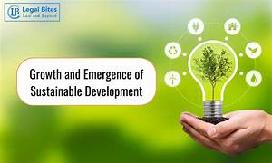

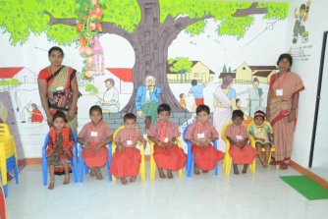

ADVANTAGES:
Transparency and Trust
Faster Resolution of Issues
Data-Driven Improvements
Facilitated Reporting of Environmental Issues
Village Development
Promotion of Social Equity
Improved Public Services
Increased Accountability of Local Authorities
Fostering Social Cohesion
Increased Awareness of Environmental Issues
Literacy
Increase
Agricultural
Development
Rural Development
Empowering Citizen Voices
5

Slide 6
Work Flow
Work Flow
Detail
Work Flow
1.Super Admin
2. Admin
3. Department
4. Employee
5. Users
Start
User Registration → OTP Verification → Profile Setup → Completed
User Login
Grievance Submission → Select Grievance Type → Submit Details → Complaint ID Generated
Complaint Forwarded to Authorities
Authorities Review Complaint → Status Updated → Timeline Assigned
Complaint Status Tracking → Real-Time Notifications Sent to User
Grievance Resolved → Notify User → User Feedback Collected
Report Generation for Monitoring → Issue Closed
Closed
Raise Complaint
Analyse Complaint by Admin
Forwarded by Admin
View By Employee
Monitor the Complaint
Closed
Update Status
Step 01
Step 02
Step 03
Step 04
Step 05

Slide 7
How does Gramvaani development help the society?
The Digital Gramvaani Platform is a powerful tool for economic reform in villages. By streamlining the reporting of local issues related to infrastructure and public services, it enables quicker resolutions that enhance service quality.
In terms of social reform, the platform empowers villagers by giving them a voice in governance, encouraging active participation in community decision-making. It helps reduce inequality by ensuring that all community members, including marginalized groups, can report grievances and access services fairly.
Economic and Social Reform:
Improving child nutrition and health
Accountability in Action
Education and mental development
A Gramvaani enhances both education and mental development by promoting a quality, inclusive, and responsive educational environment. It helps identify and solve problems related to access, safety, teacher quality, and mental health..
Gramvaani is an essential tool for improving child nutrition and health by ensuring accountability, improving service delivery, facilitating timely interventions, and fostering community trust and participation.
Voice for Justice
Service with Integrity
7

Slide 8
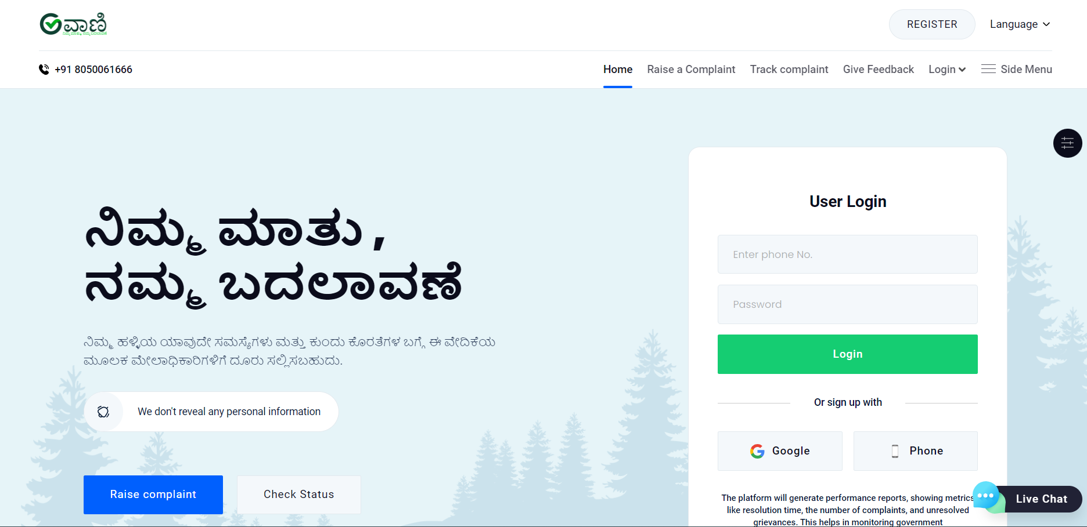
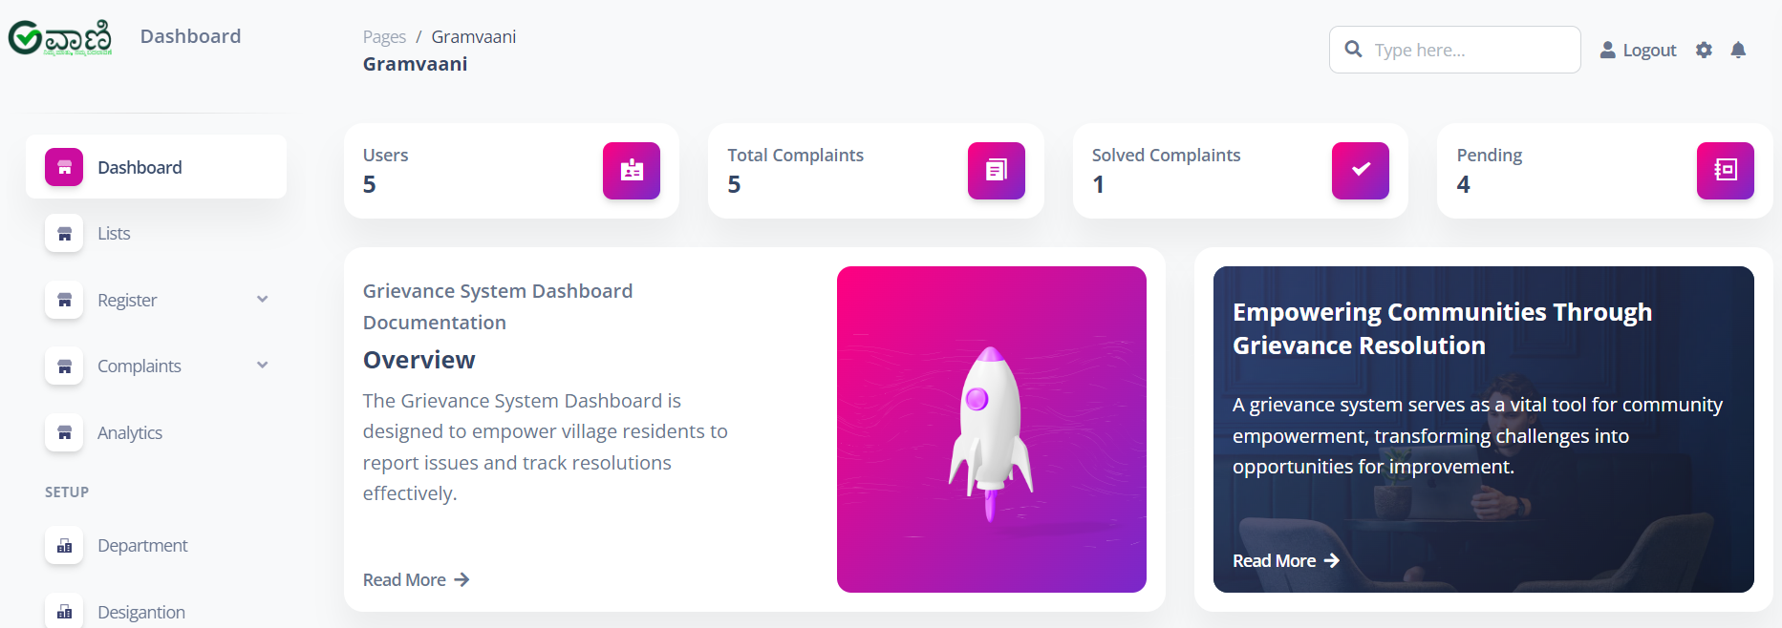
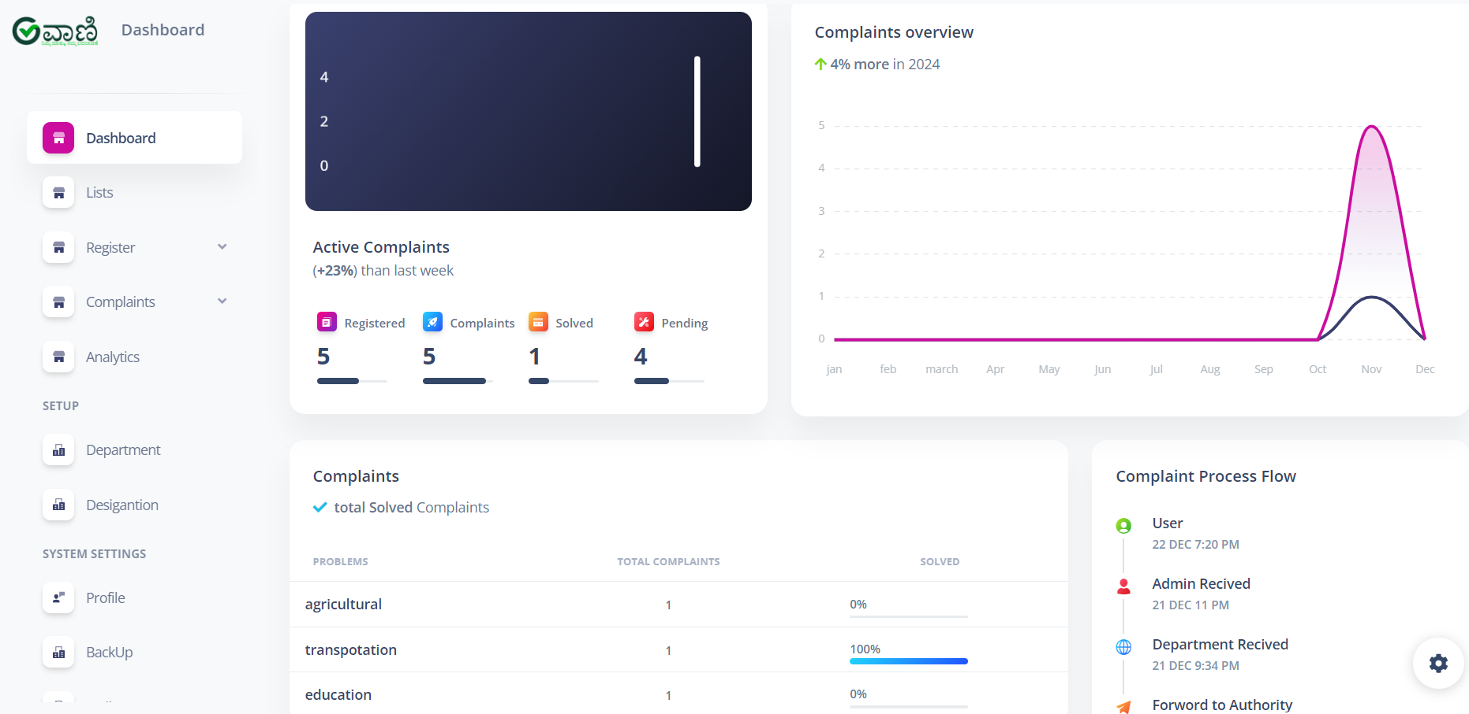
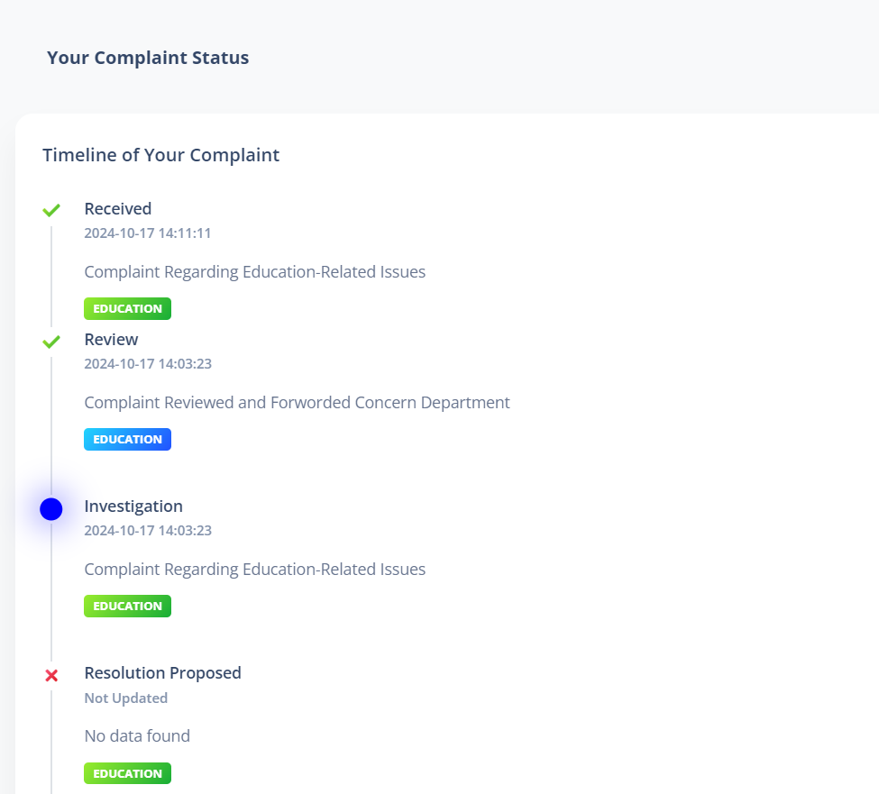

Slide 9
Before And After Gramvaani
Before
After
Inefficiencies: Complaints and issues related to poor services (e.g., education, healthcare, nutrition) often went unnoticed or were ignored, leading to persistent problems
With a Gramvaani in place, complaints and feedback directly reach decision-makers and service providers, leading to quick resolutions and service improvements.
Low Accountability: There was minimal accountability for poor service delivery. Service providers or administrators were not held responsible for failures or delays, and citizens had limited avenues to hold them accountable.
Increased Accountability: The GRS ensures that service providers, whether in education, health, or public services, are accountable to the public. When grievances are raised, they must be addressed within a specified time frame, and failure to resolve issues often leads to further scrutiny or penalties.
Limited Citizen Voice: In the absence of a formal grievance redress system, many citizens (especially in marginalized communities) had little or no opportunity to raise concerns about services. Complaints were often dismissed, ignored, or overlooked, and people felt powerless to initiate change.
Active Citizen Participation: The introduction of a GRS empowers citizens, allowing them to voice concerns, file complaints, and request improvements in services. This participatory approach leads to better-informed decisions and more responsive governance.
Slow and Inefficient: In the absence of a formal system, issues related to education, healthcare, or other public services were often resolved slowly, or not at all. Complaints could get lost in bureaucracy, leading to delays and frustration.
Faster Resolution: With a GRS in place, complaints are logged, tracked, and prioritized. Authorities are required to respond within a set time, ensuring that issues are addressed swiftly and efficiently.
Continuous Improvement: The system creates a feedback loop, where repeated grievances help highlight systemic problems and inform long-term reforms.
Through a formal mechanism, issues of discrimination, bias, or exclusion in service delivery are brought to light and corrected.
The system allows for prioritization of urgent matters, such as health emergencies, child welfare, or infrastructure failures.
People are more aware of their rights and the channels through which they can express grievances.
9

Slide 10

Gramvaani

